Slide 1
Software Engineering
Topic 3
Requirement Modelling

Slide 2
Acknowledgement
These slides have been adapted from
Pressman, R.S. (2015). Software Engineering : A Practioner's Approach. 8th ed. McGraw-Hill Companies.Inc, Americas, New York. ISBN : 978 1 259 253157. Chapter 9, 10, 11 and 12

Slide 3
LO 2 : Explain the software engineering practices and business environment
Learning Objectives

Slide 4
Contents
Requirement Analysis
Eliciting Requirements
Developing Use Case
Negotiating Requirements
Validating Requirements

Slide 5
REQUIREMENT ENGINEERING

Slide 6
Requirement Engineering
Inception—ask a set of questions that establish …
  basic understanding of the problem
  the people who want a solution
  the nature of the solution that is desired, and
  the effectiveness of preliminary communication and collaboration between the customer and the developer
Elicitation—elicit requirements from all stakeholders
Elaboration—create an analysis model that identifies data, function and behavioral requirements
Negotiation—agree on a deliverable system that is realistic for developers and customers

Slide 7
Requirement Engineering
Specification—can be any one (or more) of the following:
  A written document
  A set of models
  A formal mathematical
  A collection of user scenarios (use-cases)
  A prototype
Validation—a review mechanism that looks for
  errors in content or interpretation
  areas where clarification may be required
  missing information
  inconsistencies (a major problem when large products or systems are engineered)
  conflicting or unrealistic (unachievable) requirements.
Requirements management

Slide 8
Requirement Engineering
Inception
Identify stakeholders
  “who else do you think I should talk to?”
Recognize multiple points of view
Work toward collaboration
The first questions
  Who is behind the request for this work?
  Who will use the solution?
  What will be the economic benefit of a successful solution
  Is there another source for the solution that you need?

Slide 9
Requirement Engineering
Eliciting Requirements
Meetings are conducted and attended by both software engineers and customers
Rules for preparation and participation are established
An agenda is suggested
A "facilitator" (can be a customer, a developer, or an outsider) controls the meeting
A "definition mechanism" (can be work sheets, flip charts, or wall stickers or an electronic bulletin board, chat room or virtual forum) is used
The goal is
  to identify the problem
  propose elements of the solution
  negotiate different approaches, and
  specify a preliminary set of solution requirements

Slide 10
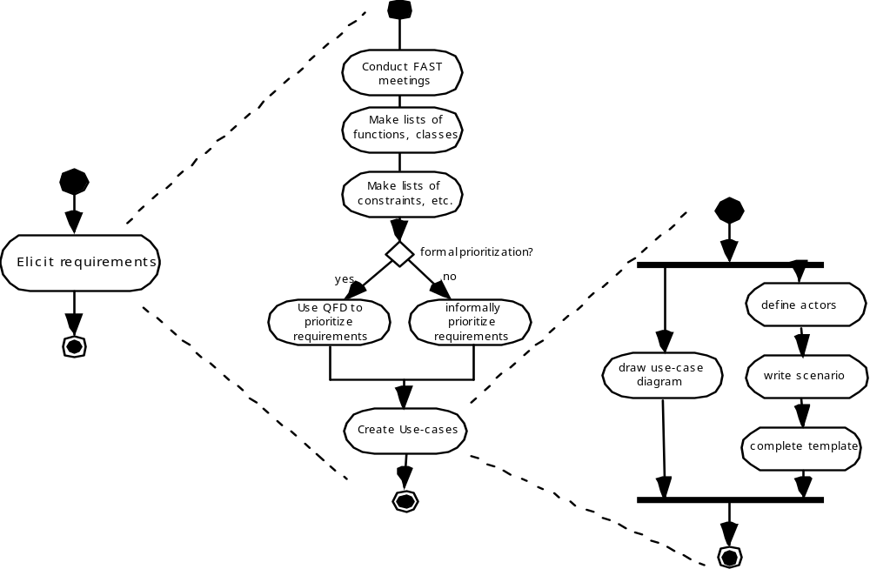
Requirement Engineering
Eliciting Requirements

Slide 11
Requirement Engineering
Quality Function Deployment
Function deployment determines the “value” (as perceived by the customer) of each function required of the system
Information deployment identifies data objects and events
Task deployment examines the behavior of the system
Value analysis determines the relative priority of requirements

Slide 12
Requirement Engineering
Elicitation Work Products
a statement of need and feasibility.
a bounded statement of scope for the system or product.
a list of customers, users, and other stakeholders who participated in requirements elicitation
a description of the system’s technical environment.
a list of requirements (preferably organized by function) and the domain constraints that apply to each.
a set of usage scenarios that provide insight into the use of the system or product under different operating conditions.
any prototypes developed to better define requirements.

Slide 13
BUILDING THE ANALYSIS MODEL

Slide 14
Building the Analysis Model
Elements of the analysis model :
Scenario-based elements
  Functional—processing narratives for software functions
  Use-case—descriptions of the interaction between an “actor” and the system
Class-based elements
  Implied by scenarios
Behavioral elements
  State diagram
Flow-oriented elements
  Data flow diagram

Slide 15
Building the Analysis Model
Use-Cases
A collection of user scenarios that describe the thread of usage of a system
Each scenario is described from the point-of-view of an “actor”—a person or device that interacts with the software in some way
Each scenario answers the following questions:
  Who is the primary actor, the secondary actor (s)?
  What are the actor’s goals?
  What preconditions should exist before the story begins?
  What main tasks or functions are performed by the actor?
  What extensions might be considered as the story is described?
  What variations in the actor’s interaction are possible?
  What system information will the actor acquire, produce, or change?
  Will the actor have to inform the system about changes in the external environment?
  What information does the actor desire from the system?
  Does the actor wish to be informed about unexpected changes?

Slide 16
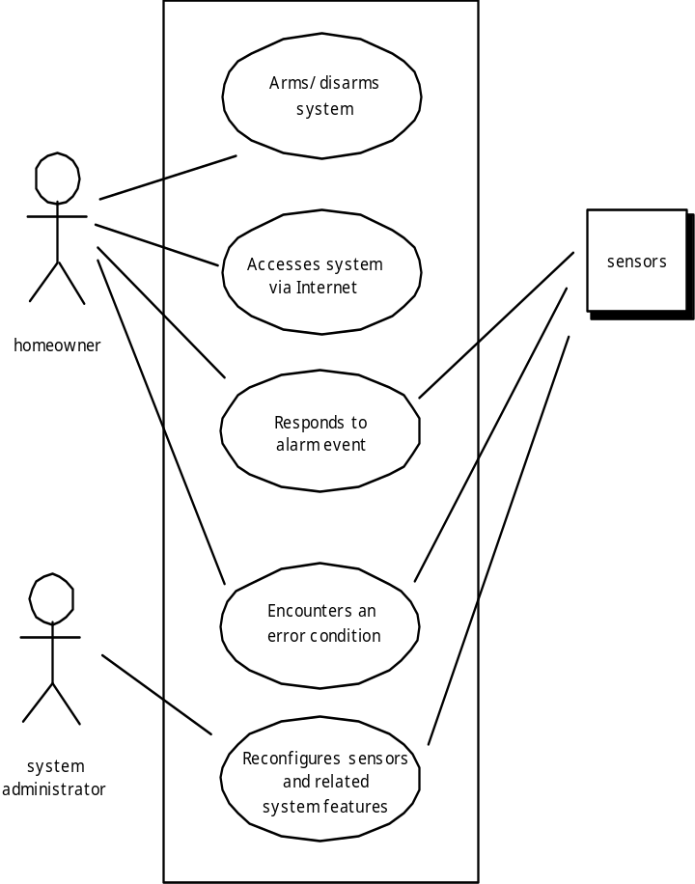
Building the Analysis Model
Use-Case Diagram

Slide 17
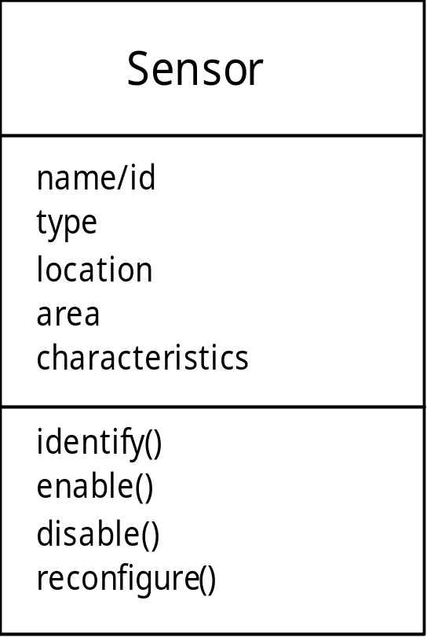
Building the Analysis Model
Class Diagram
From the SafeHome system …

Slide 18
Building the Analysis Model
State Diagram
Reading
Commands
State name
System status = “ready”
Display msg = “enter cmd”
Display status = steady
State variables
Entry/subsystems ready
Do: poll user input panel
Do: read user input
Do: interpret user input
State activities

Slide 19
Analysis Patterns
  Pattern name: A descriptor that captures the essence of the pattern.
  Intent: Describes what the pattern accomplishes or represents
  Motivation: A scenario that illustrates how the pattern can be used to address the problem.
  Forces and context: A description of external issues (forces) that can affect how the pattern is used and also the external issues that will be resolved when the pattern is applied.
  Solution: A description of how the pattern is applied to solve the problem with an emphasis on structural and behavioral issues.
  Consequences: Addresses what happens when the pattern is applied and what trade-offs exist during its application.
  Design: Discusses how the analysis pattern can be achieved through the use of known design patterns.
  Known uses: Examples of uses within actual systems.
  Related patterns: On e or more analysis patterns that are related to the named pattern because (1) it is commonly used with the named pattern; (2) it is structurally similar to the named pattern; (3) it is a variation of the named pattern.

Slide 20
Negotiating Requirements
Identify the key stakeholders
  These are the people who will be involved in the negotiation
Determine each of the stakeholders “win conditions”
  Win conditions are not always obvious
Negotiate
  Work toward a set of requirements that lead to “win-win”

Slide 21
Validating Requirements
Is each requirement achievable in the technical environment that will house the system or product?
Is each requirement testable, once implemented?
Does the requirements model properly reflect the information, function and behavior of the system to be built.
Has the requirements model been “partitioned” in a way that exposes progressively more detailed information about the system.
Have requirements patterns been used to simplify the requirements model. Have all patterns been properly validated? Are all patterns consistent with customer requirements?

Slide 22
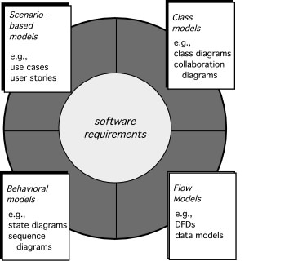
Requirement Analysis

Slide 23
REQUIREMENT MODELING

Slide 24
Scenario-Based Modeling
“[Use-cases] are simply an aid to defining what exists outside the system (actors) and what should be performed by the system (use-cases).” Ivar Jacobson
  (1) What should we write about?
  (2) How much should we write about it?
  (3) How detailed should we make our description?
  (4) How should we organize the description?

Slide 25
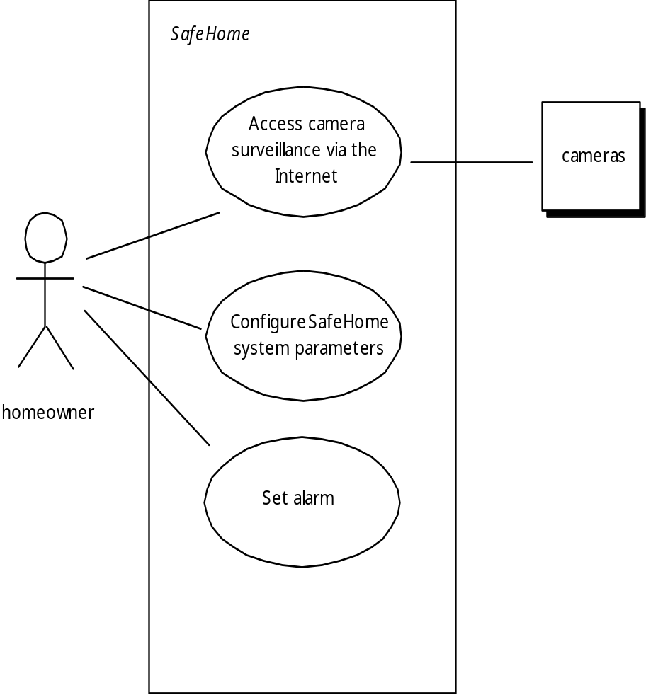
Scenario-Based Modeling
Use-Cases
a scenario that describes a “thread of usage” for a system
actors represent roles people or devices play as the system functions
users can play a number of different roles for a given scenario

Slide 26
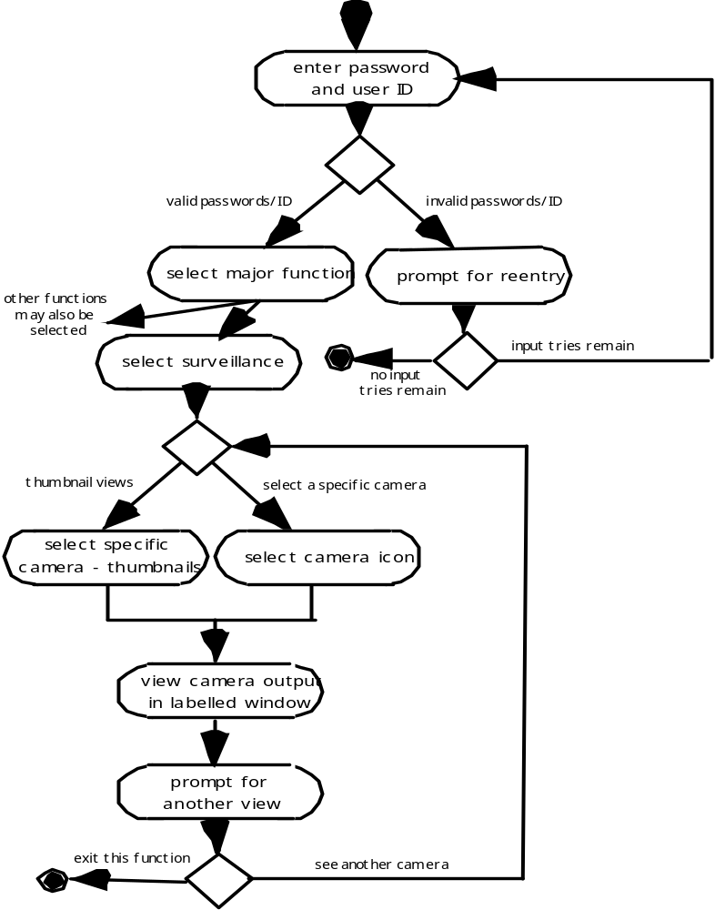
Scenario-Based Modeling
Activity Diagram
Supplements the use case by providing a graphical representation of the flow of interaction within a specific scenario

Slide 27
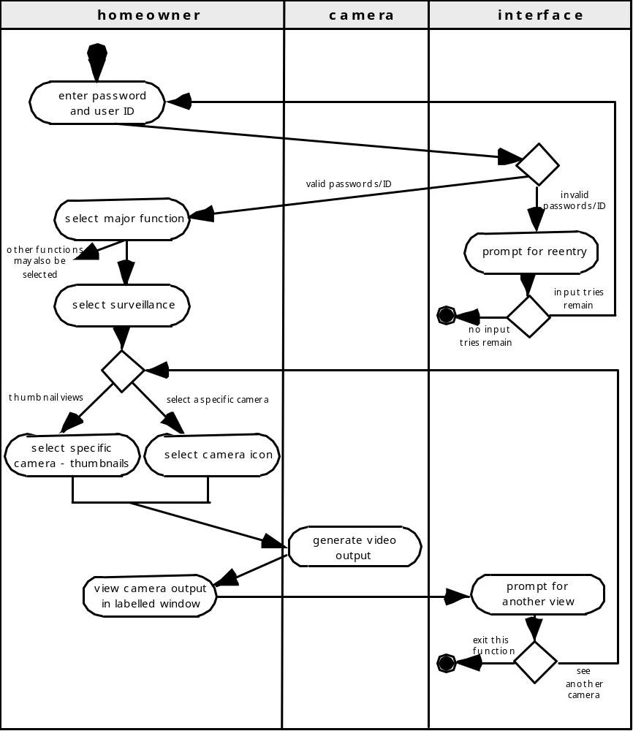
Swimlane Diagrams
Scenario-Based Modeling
Allows the modeler to represent the flow of activities described by the use-case and at the same time indicate which actor (if there are multiple actors involved in a specific use-case) or analysis class has responsibility for the action described by an activity rectangle

Slide 28
Class-Based Modeling
Class-based modeling represents:
  objects that the system will manipulate
  operations (also called methods or services) that will be applied to the objects to effect the manipulation
  relationships (some hierarchical) between the objects
  collaborations that occur between the classes that are defined.
The elements of a class-based model include classes and objects, attributes, operations, CRC models, collaboration diagrams and packages.

Slide 29
Identifying Analysis Classes
Class-Based Modeling
Examining the usage scenarios developed as part of the requirements model and perform a "grammatical parse" [Abb83]
  Classes are determined by underlining each noun or noun phrase and entering it into a simple table.
  Synonyms should be noted.
  If the class (noun) is required to implement a solution, then it is part of the solution space; otherwise, if a class is necessary only to describe a solution, it is part of the problem space.
But what should we look for once all of the nouns have been isolated?

Slide 30
Class-Based Modeling
Manifestations of Analysis Classes
Analysis classes manifest themselves in one of the following ways:
External entities: (e.g., other systems, devices, people) that produce or consume information
Things: (e.g, reports, displays, letters, signals) that are part of the information domain for the problem
Occurrences or events: (e.g., a property transfer or the completion of a series of robot movements) that occur within the context of system operation
Roles: (e.g., manager, engineer, salesperson) played by people who interact with the system
Organizational units: (e.g., division, group, team) that are relevant to an application
Places: (e.g., manufacturing floor or loading dock) that establish the context of the problem and the overall function
Structures: (e.g., sensors, four-wheeled vehicles, or computers) that define a class of objects or related classes of objects

Slide 31
Class-Based Modeling
Defining Attributes
Attributes describe a class that has been selected for inclusion in the analysis model.
  build two different classes for professional baseball players
    For Playing Statistics software: name, position, batting average, fielding percentage, years played, and games played might be relevant
    For Pension Fund software: average salary, credit toward full vesting, pension plan options chosen, mailing address, and the like.

Slide 32
Defining Operations
Class-Based Modeling
Do a grammatical parse of a processing narrative and look at the verbs
Operations can be divided into four broad categories:
  (1) operations that manipulate data in some way (e.g., adding, deleting, reformatting, selecting)
  (2) operations that perform a computation
  (3) operations that inquire about the state of an object, and
  (4) operations that monitor an object for the occurrence of a controlling event.

Slide 33
Class-Based Modeling
CRC Models
Class-responsibility-collaborator (CRC) modeling [Wir90] provides a simple means for identifying and organizing the classes that are relevant to system or product requirements. Ambler [Amb95] describes CRC modeling in the following way:
  A CRC model is really a collection of standard index cards that represent classes. The cards are divided into three sections. Along the top of the card you write the name of the class. In the body of the card you list the class responsibilities on the left and the collaborators on the right.

Slide 34
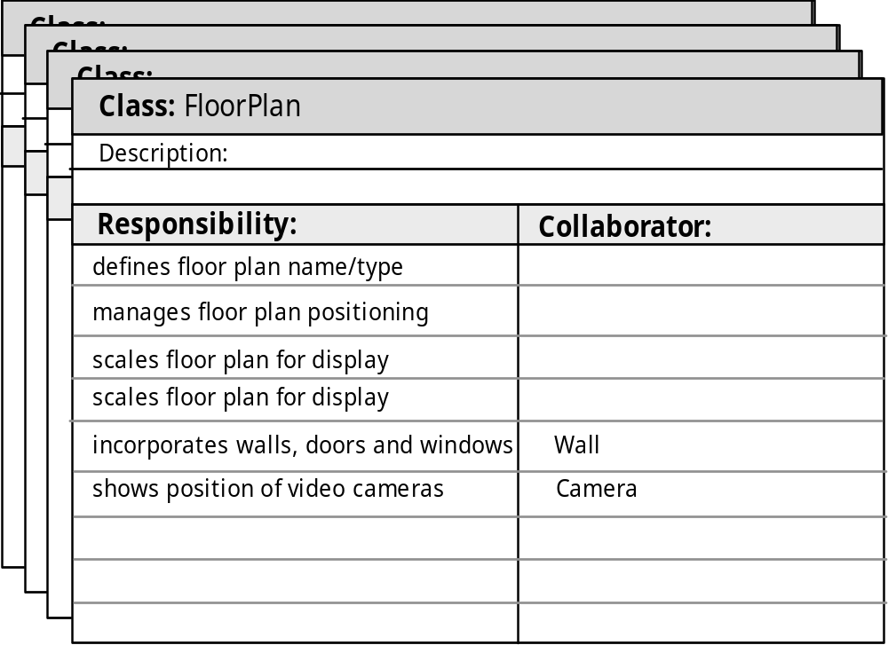
CRC Modeling
Class-Based Modeling

Slide 35

Composite Aggregate Class
Class-Based Modeling

Slide 36
Associations and Dependencies
Class-Based Modeling
Two analysis classes are often related to one another in some fashion
  In UML these relationships are called associations
  Associations can be refined by indicating multiplicity (the term cardinality is used in data modeling
In many instances, a client-server relationship exists between two analysis classes.
  In such cases, a client-class depends on the server-class in some way and a dependency relationship is established

Slide 37
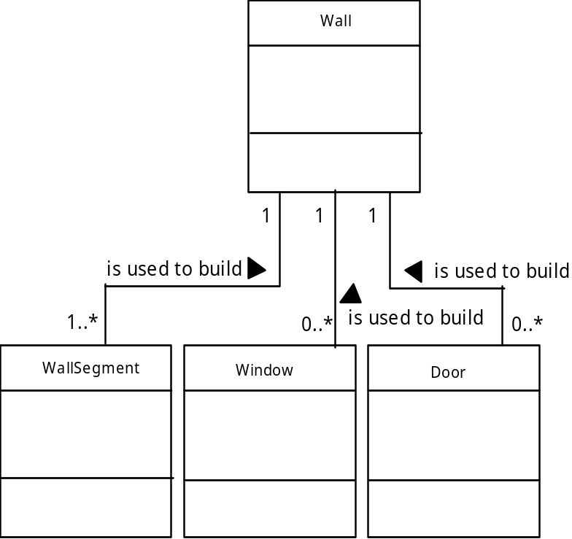
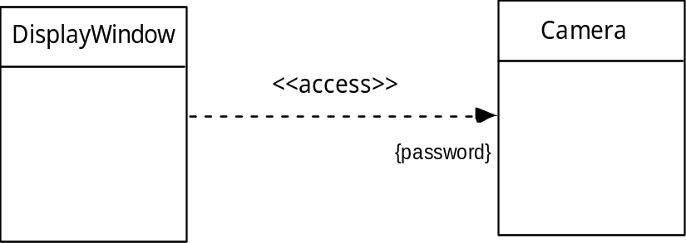
Class-Based Modeling
Multiplicity
Dependencies

Slide 38
Analysis Packages
Class-Based Modeling
Various elements of the analysis model (e.g., use-cases, analysis classes) are categorized in a manner that packages them as a grouping
The plus sign preceding the analysis class name in each package indicates that the classes have public visibility and are therefore accessible from other packages.
Other symbols can precede an element within a package. A minus sign indicates that an element is hidden from all other packages and a # symbol indicates that an element is accessible only to packages contained within a given package.

Slide 39
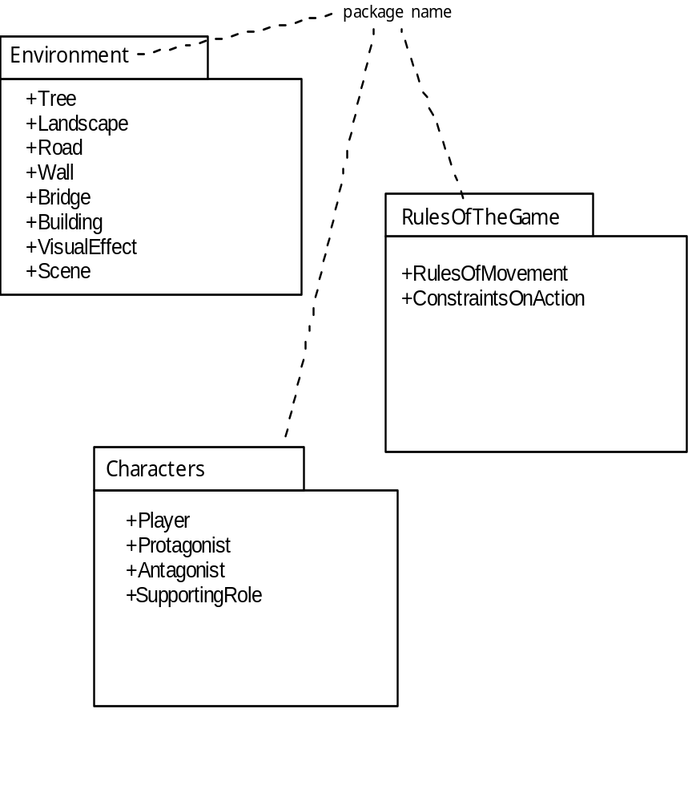
Analysis Packages
Class-Based Modeling

Slide 40
Creating A Behavioral
Modeling
The behavioral model indicates how software will respond to external events or stimuli. To create the model, the analyst must perform the following steps:
    Evaluate all use-cases to fully understand the sequence of interaction within the system.
    Identify events that drive the interaction sequence and understand how these events relate to specific objects.
    Create a sequence for each use-case.
    Build a state diagram for the system.
    Review the behavioral model to verify accuracy and consistency.

Slide 41
State Representations
Creating A Behavioral
Modeling
In the context of behavioral modeling, two different characterizations of states must be considered:
  the state of each class as the system performs its function and
  the state of the system as observed from the outside as the system performs its function
The state of a class takes on both passive and active characteristics [CHA93].
  A passive state is simply the current status of all of an object’s attributes.
  The active state of an object indicates the current status of the object as it undergoes a continuing transformation or processing.

Slide 42
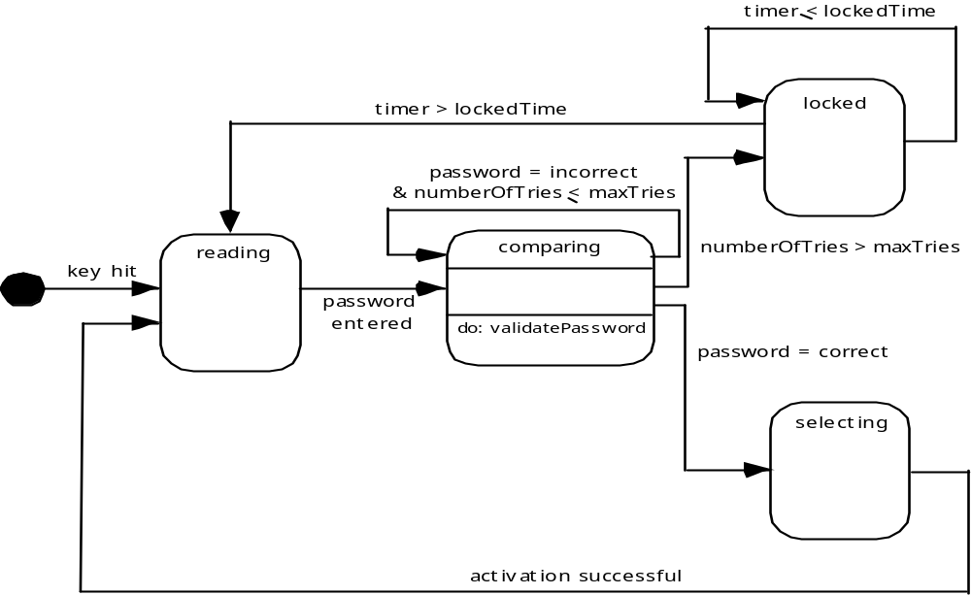
State Diagram for the ControlPanel Class
Creating A Behavioral
Modeling

Slide 43
The States of a System
Creating A Behavioral
Modeling
state—a set of observable circum-stances that characterizes the behavior of a system at a given time
state transition—the movement from one state to another
event—an occurrence that causes the system to exhibit some predictable form of behavior
action—process that occurs as a consequence of making a transition

Slide 44
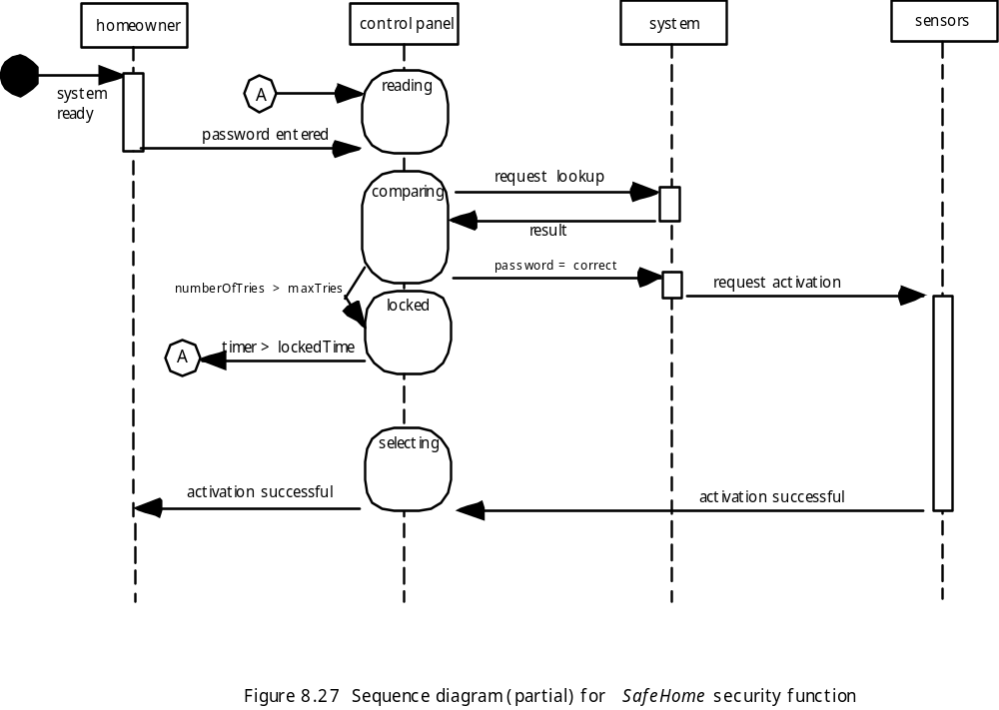
Sequence Diagram
Creating A Behavioral
Modeling

Slide 45
REQUIREMENT MODELING FOR WEB AND MOBILE APPS

Slide 46
Requirements Modeling for Web and Mobile Apps
When Do We Perform Analysis?
In some WebE situations, analysis and design merge. However, an explicit analysis activity occurs when …
  the WebApp to be built is large and/or complex
  the number of stakeholders is large
  the number of Web engineers and other contributors is large
  the goals and objectives (determined during formulation) for the WebApp will effect the business’ bottom line
  the success of the WebApp will have a strong bearing on the success of the business

Slide 47
Requirements Modeling
for Web and Mobile Apps
The Content Model
Content objects are extracted from use-cases
  examine the scenario description for direct and indirect references to content
Attributes of each content object are identified
The relationships among content objects and/or the hierarchy of content maintained by a WebApp
  Relationships—entity-relationship diagram or UML
  Hierarchy—data tree or UML

Slide 48
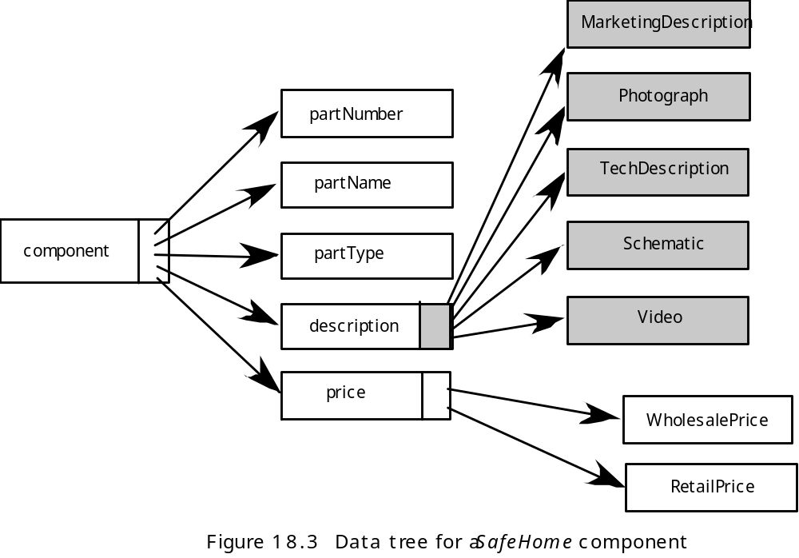
Requirements Modeling
for Web and Mobile Apps
Data Tree

Slide 49
Requirements Modeling
for Web and Mobile Apps
The Interaction Model
Composed of four elements:
  use-cases
  sequence diagrams
  state diagrams
  a user interface prototype

Slide 50
Requirements Modeling
for Web and Mobile Apps
The Functional Model
The functional model addresses two processing elements of the WebApp
  user observable functionality that is delivered by the WebApp to end-users
  the operations contained within analysis classes that implement behaviors associated with the class.
An activity diagram can be used to represent processing flow

Slide 51
Requirements Modeling
for Web and Mobile Apps
The Configuration Model
Server-side
  Server hardware and operating system environment must be specified
  Interoperability considerations on the server-side must be considered
  Appropriate interfaces, communication protocols and related collaborative information must be specified
Client-side
  Browser configuration issues must be identified
  Testing requirements should be defined

Slide 52
References
Pressman, R.S. (2015). Software Engineering : A Practioner's Approach. 8th ed. McGraw-Hill Companies.Inc, Americas, New York. ISBN : 978 1 259 253157
UML Specification, https://www.omg.org/spec/UML/About-UML/
UML 2.0 Tutorial, http://www.youtube.com/watch?v=OkC7HKtiZC0
Introduction to Model-View-View-Model (MVVM) Pattern, http://www.youtube.com/watch?v=pY60lLotZCg

Slide 53
Q & A

